Slide 1
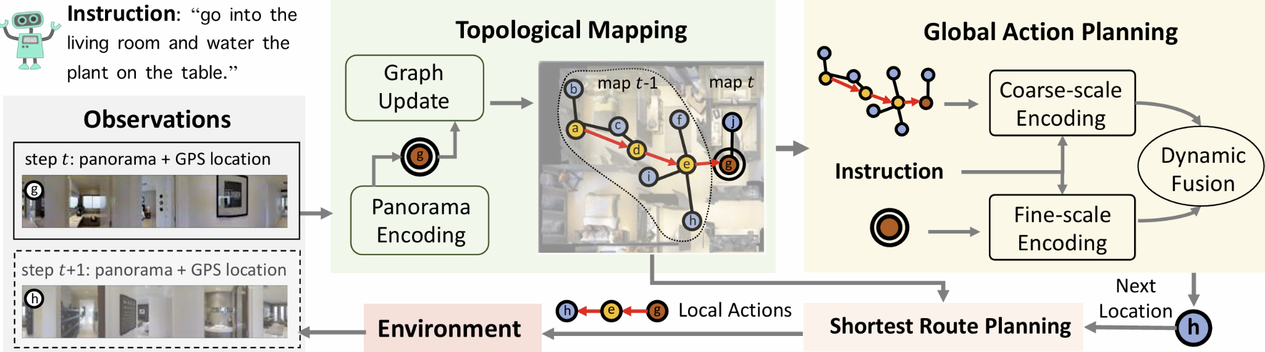
PathMoE: Modular Expert Booster for Robust Vision-and-Language Navigation
COMP 560 Final Presentation Apr 24, 2025
Mulang Shi, Mingzhe Zhou, Dan Peng, Haoyang Li

Slide 2
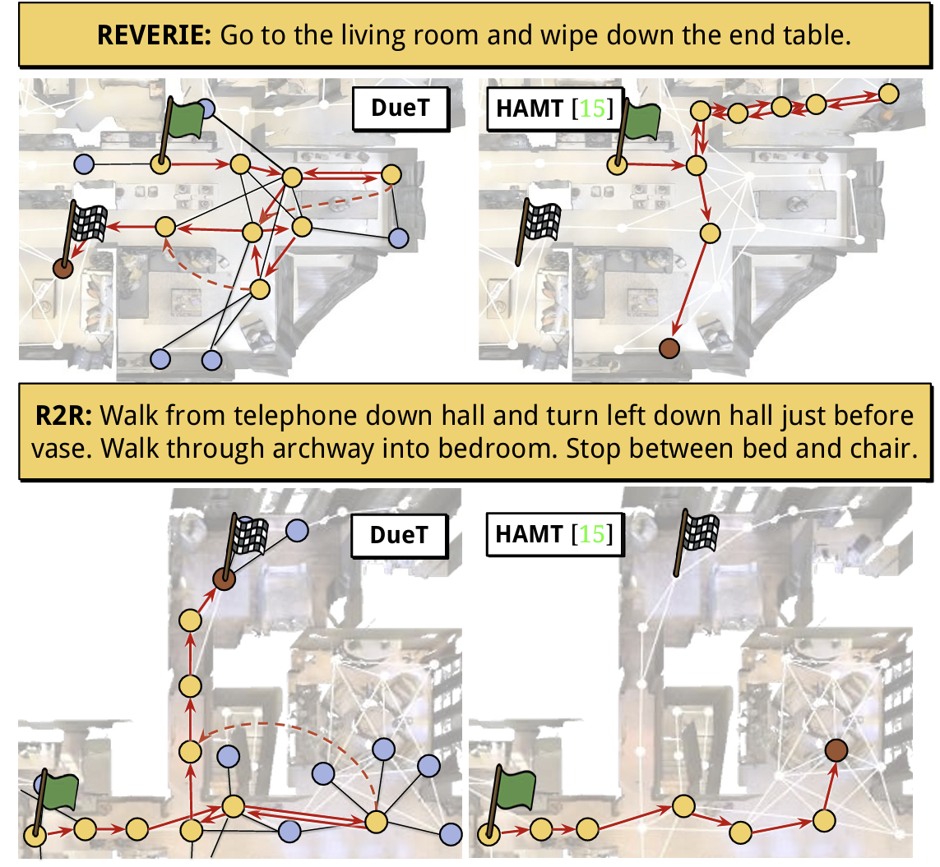
Problem & Motivation
COMP 560 Final Presentation Apr 24, 2025
What is Vision-and-Language Navigation (VLN)?
An embodied agent receives natural language instructions and navigates indoor environments.
Language <-> Visual alignment is crucial
🚩 Key Challenges
Baseline VLN-DUET: A strong transformer-based agent for this task but has sparse instruction alignment with visual path
Baseline Dataset(R2R) annotations are coarse-grained and sometimes ambiguous
Data-hungry model; small instruction dataset

Slide 3
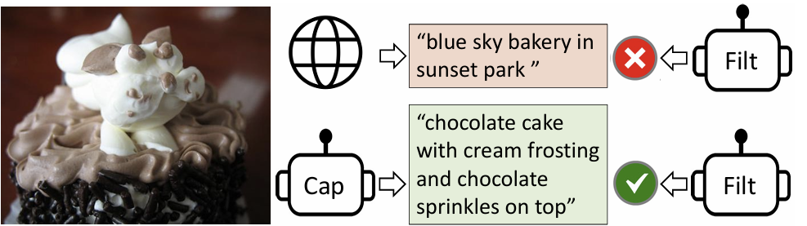
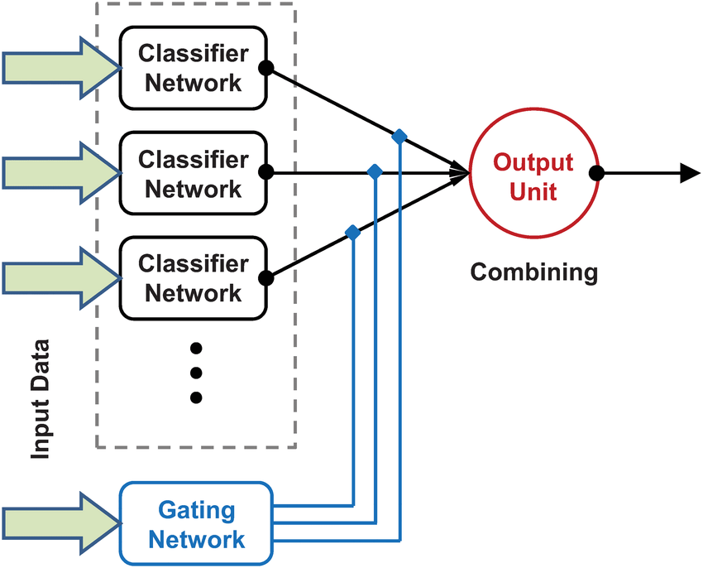
Method&System Design
COMP 560 Final Presentation Apr 24, 2025
Our Solution: Modular Expert Booster
A modular Mixture-of-Experts system for navigation, leveraging vision-language decomposition
BLIP Captioning as a frozen visual expert
MatterSim for spatial grounding (heading + elevation)
LLAMA3-70B, using LLAMA-FACTORY, finetuned as a language planner expert
No need for end-to-end VLMs—interpretable, lightweight, effective
Our Experts!
Visual Expert: BLIP generates rich descriptions of each viewpoint
Spatial Expert: MatterSim simulates agent’s pose (heading, elevation)
LLM Expert: Finetuned LLAMA3-70B generates detailed, grounded better instructions
Prompt = Router: Chain-of-Thought template combines visual + spatial + example
Modular = Flexible, interpretable, plug-and-play architecture

Slide 4
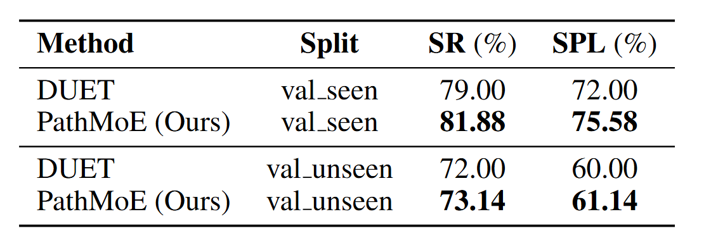
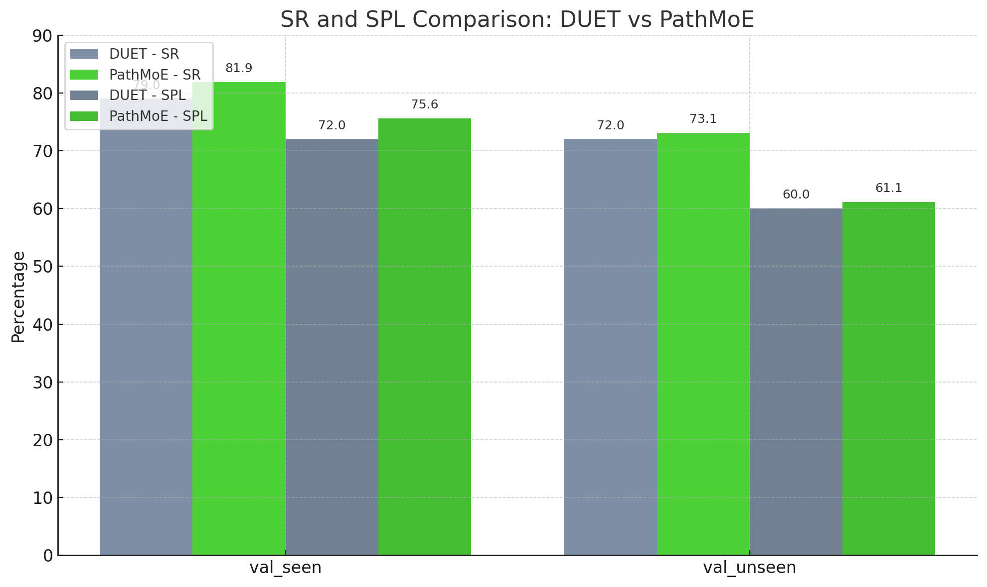
Result
COMP 560 Final Presentation Apr 24, 2025
Evaluation on R2R: PathMoE(ENHANCED-DUET) vs Baseline(DUET)
OUR OUTPUT
'turn slightly right and go down the hallway', 'continue down the hallway past the living room until you get to a large painting on the right wall', 'turn to the right at the entrance to a bathroom', 'and go into the bathroom', 'go down the hallway on the right', 'and turn right into the bathroom through the doorway right next to the stair'
ORIGINAL DATASET INPUT
'walk through the walkway to the left of the wired man, and take you first right into a room. walk into the room, and stop once you reach the gray carpet lying on the ground.',
'go into the hallway and to the right. wait in the office, in front of the loveseat.',
'exit the room to the left of the statue. turn right into the first door on the right.'

Slide 5
Demo
COMP 560 Final Presentation Apr 24, 2025

Slide 6
Thank you
COMP 560 Final Presentation Apr 24, 2025
mlshi@cs.unc.edu, danpeng@unc.edu, mzhou@unc.edu, vicli@unc.edu
Cite:
arXiv:2201.12086 [cs.CV] BLIP: Bootstrapping Language-Image Pre-training for Unified Vision-Language Understanding and Generation
arXiv:2403.13372 [cs.CL] LlamaFactory: Unified Efficient Fine-Tuning of 100+ Language Models
arXiv:2202.11742 [cs.CV] Think Global, Act Local: Dual-scale Graph Transformer for Vision-and-Language Navigation
arXiv:1711.07280 [cs.CV] Vision-and-Language Navigation: Interpreting visually-grounded navigation instructions in real environments

